Slide 1
Big Data and the Life Sciences
Joshua T. Vogelstein, James Taylor, Elana Fertig, Alexis Battle

Slide 2
What is Big Data Science for the Life Sciences?
A field that develops, applies and combines big data systems and machine learning / artificial intelligence with life science domain knowledge to improve health and healthcare.

Slide 3
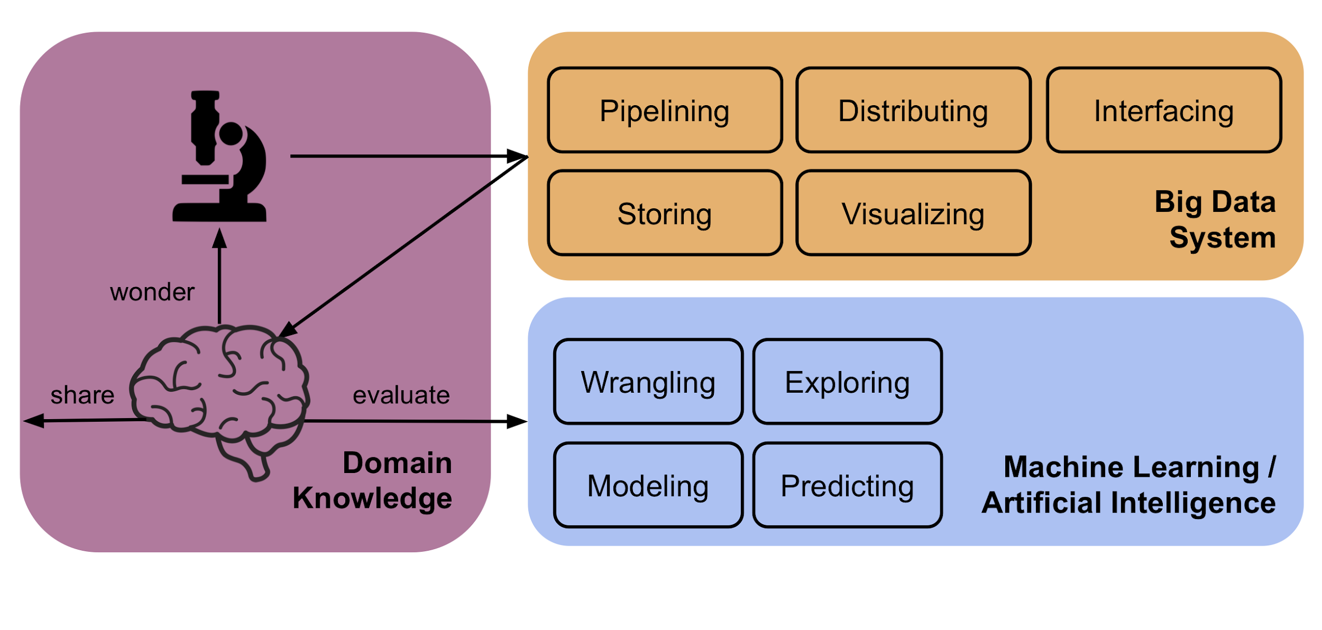

Slide 4
Why is it hard?
Each stage of the data analysis workflow is broken by big data:
Volume - each genome is 1B bytes
Velocity - can generate TBs per day
Variety - images, questionnaires, text, ‘omics, time-series
Veracity - lots of noise

Slide 5
Why is it hard?
Life sciences introduce a number of additional challenges
Wide: sample size is ~10, dimensionality is ~10⁹
Multiscale: molecules, cells, tissues, organs, individuals, populations
Interpretable: doctors, scientists, insurers must understand

Slide 6
NeuroData
Joshua T. Vogelstein
http://neurodata.io

Slide 7
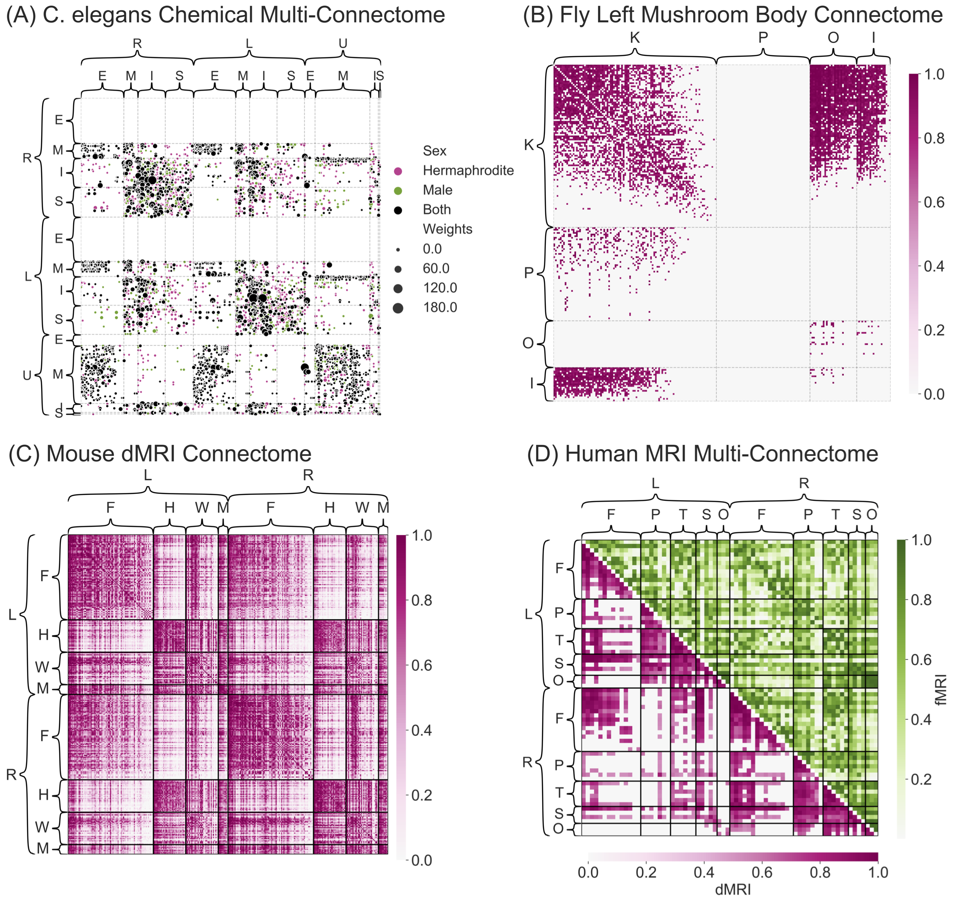
NeuroData
Neural coding is about brain activity & info. representation
Connectal coding is about brain connectivity & info. storage
Connectopathies underly psychiatric & learning disorders
Depression is leading cause of disability worldwide
Vogelstein et al., Current Opinion in Neurobiology (2019)
http://neurodata.io

Slide 8
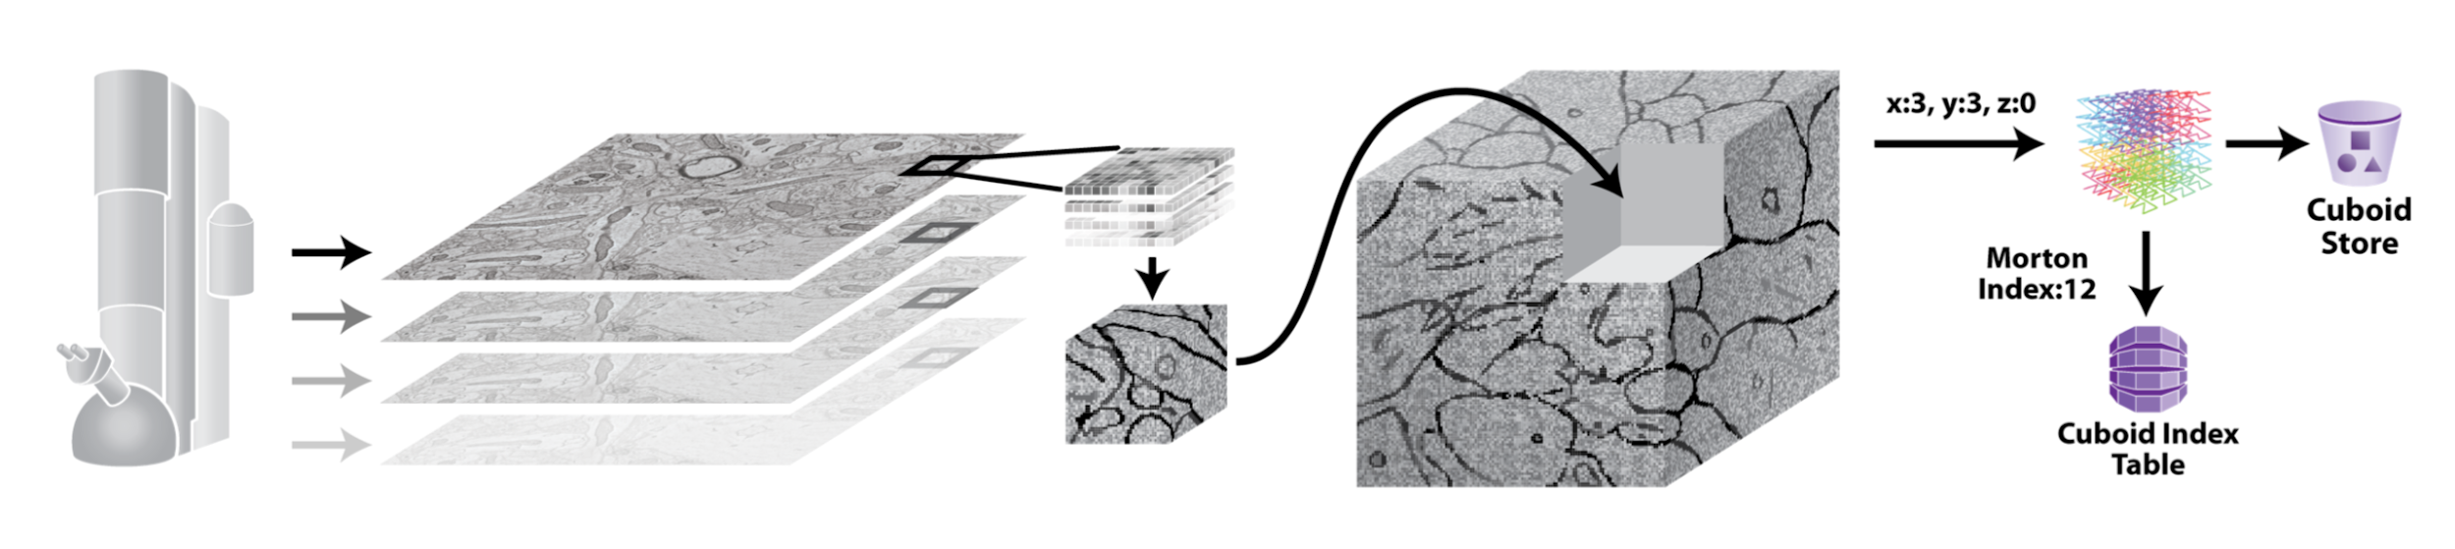
Storing
Extended SDSS database
Support 3D + multi-spectral data
Now host the largest open source brain image repo in the world
Vogelstein et al., Nature Methods, 2018 (https://neurodata.io/ndcloud/)
Vogelstein et al., Nature Methods (2018)
http://neurodata.io/ndcloud/

Slide 9
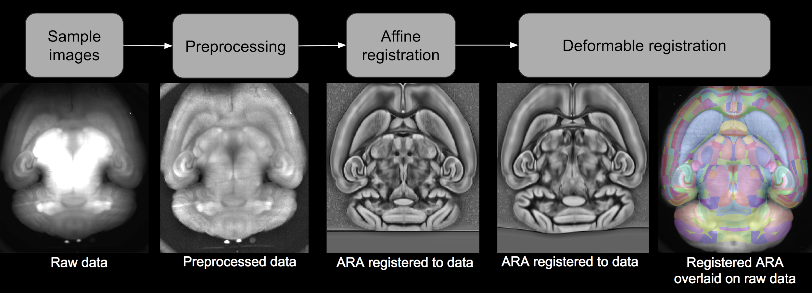
Wrangling
10 TB raw image volume
Bias correct, stitch, register, align
Multi-contrast nonlinear deformation
Kutten et al., MICCAI (2017)
http://neurodata.io/ndreg/

Slide 10
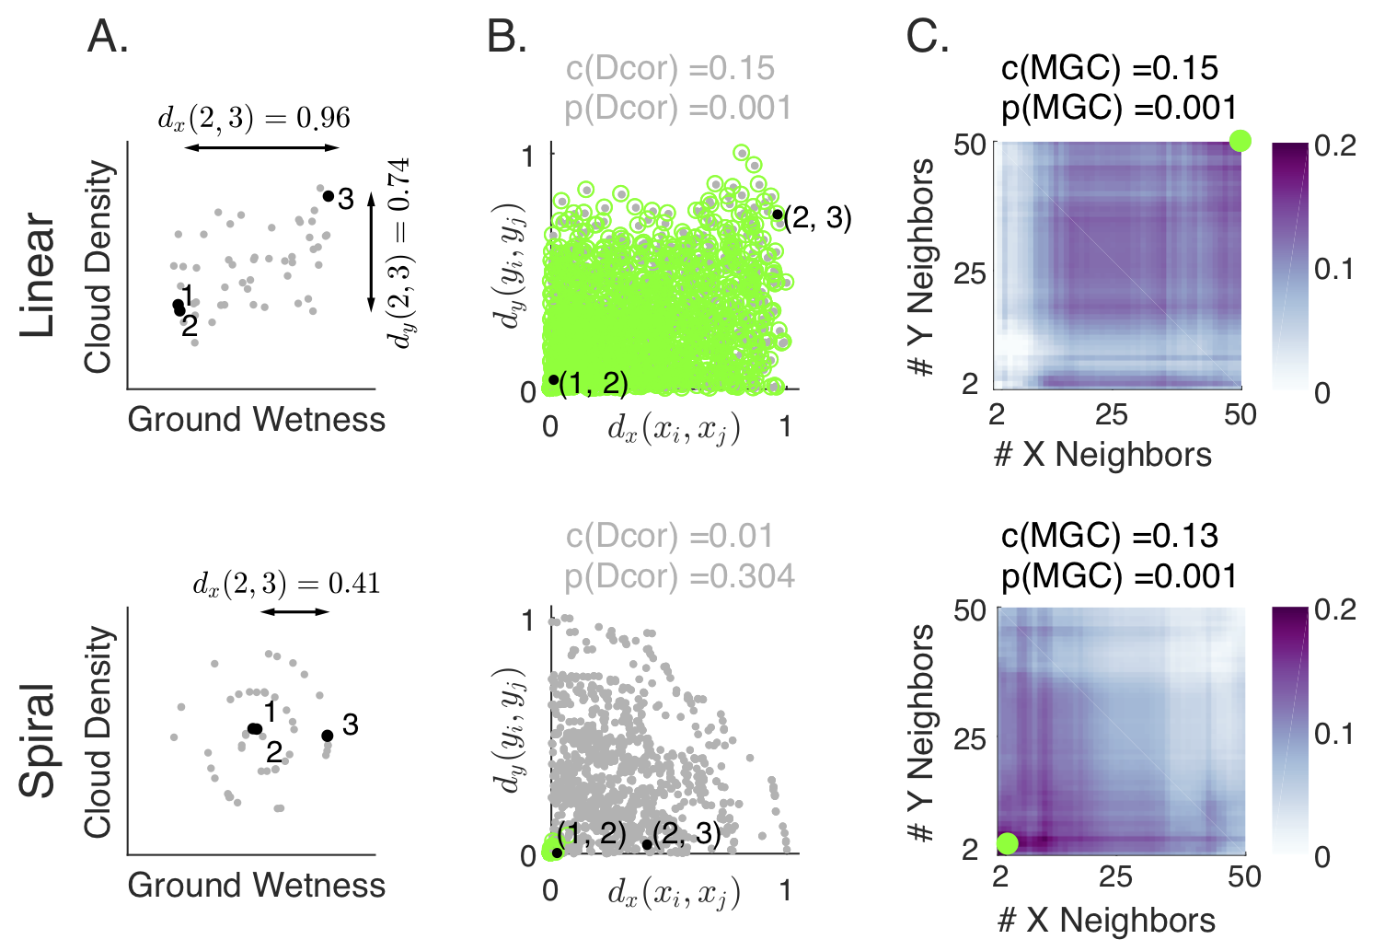
Exploring
Often faced with high-dimensional multi-modal data
Desire to understand which variables are nonlinearly associated
Juxtapose harmonic analysis with manifold learning
Vogelstein et al., eLife (2019)
http://neurodata.io/mgc/

Slide 11
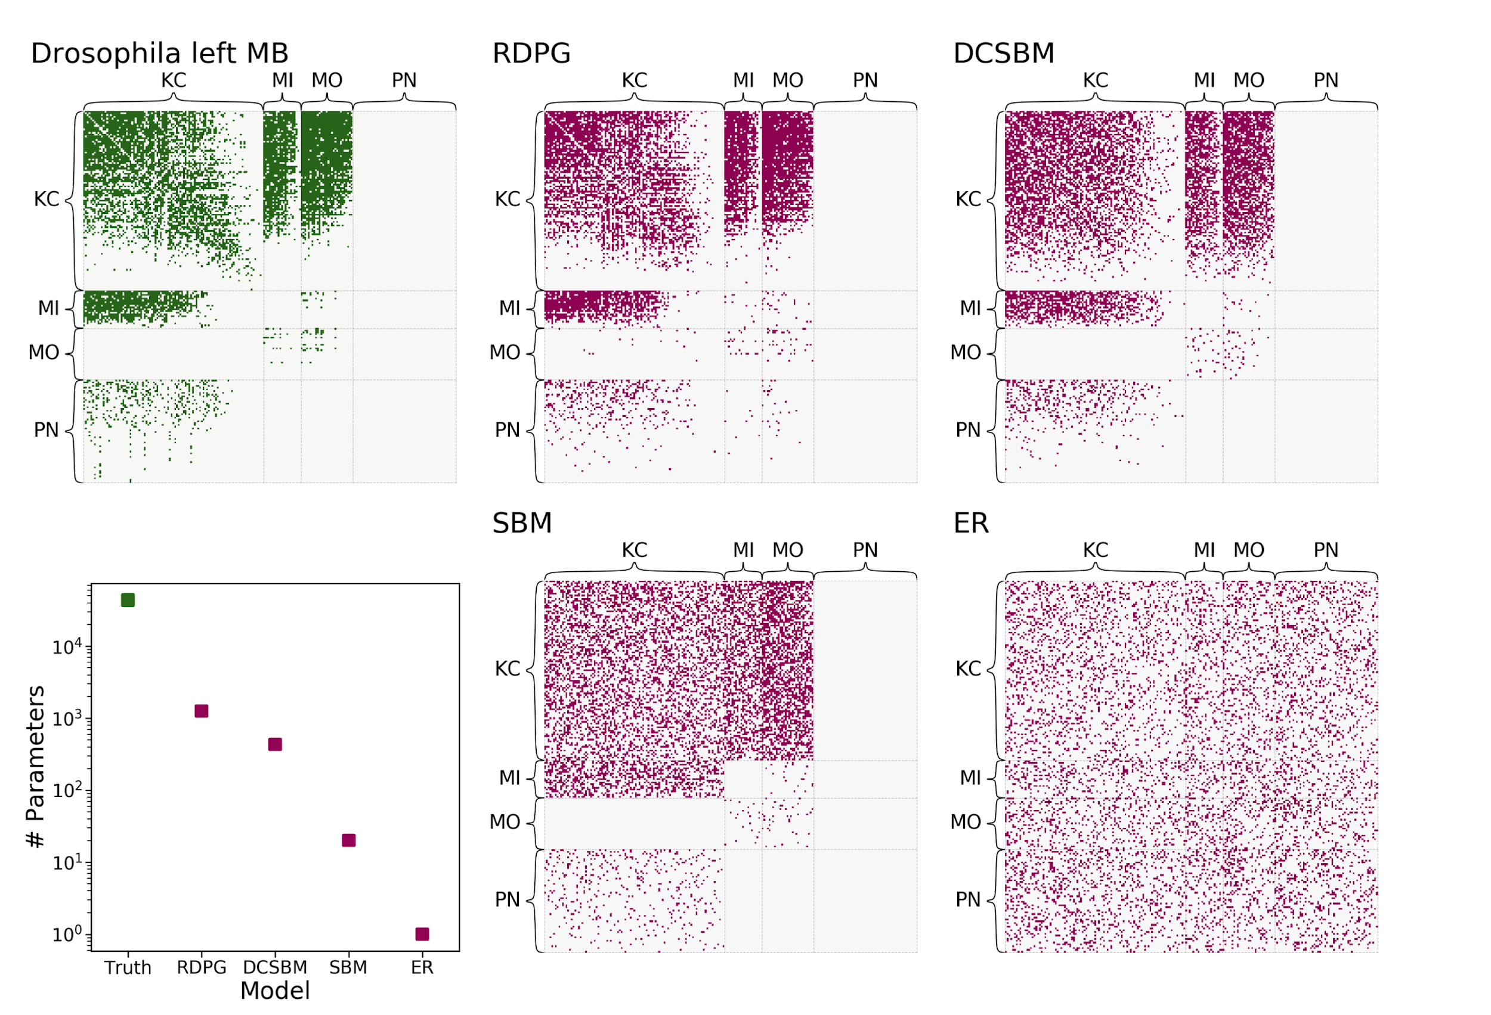
Modeling
Larval Drosophila Mushroom Body Connectome
Network valued data
Parsimonious models enable estimation & testing
Athreya et al., JMLR (2018)
http://neurodata.io/graspy/

Slide 12
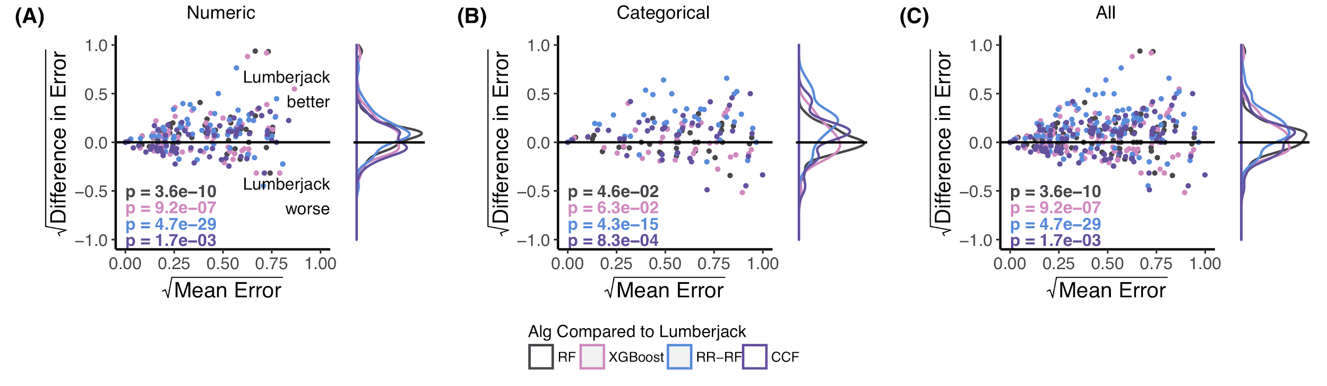
Predicting
Must predict class or magnitude from high-dimensional data
Requires interpretable predictions
Juxtapose random matrix theory and decision forests
Tomita et al., arXiv (2018)
http://neurodata.io/rerf/

Slide 13





Acknowledgements

